Slide 1
Pertemuan 13
Dosen : Niki Ratama, S.Kom., M.Kom Pemrograman 1

Slide 2
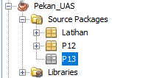
Buatlah projek dan package
Buatlah projek “namakamu_pekanUAS”
Buatlah package “P13”

Slide 3
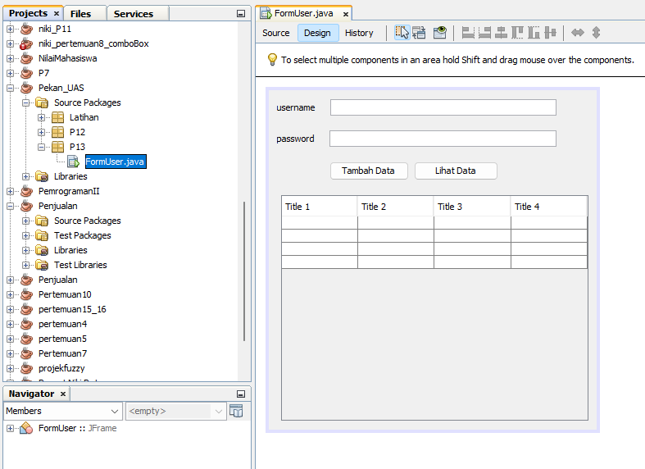
Buatlah Jframe “FormUser”
Buatlah desain jFrame sebagai berikut :

Slide 4
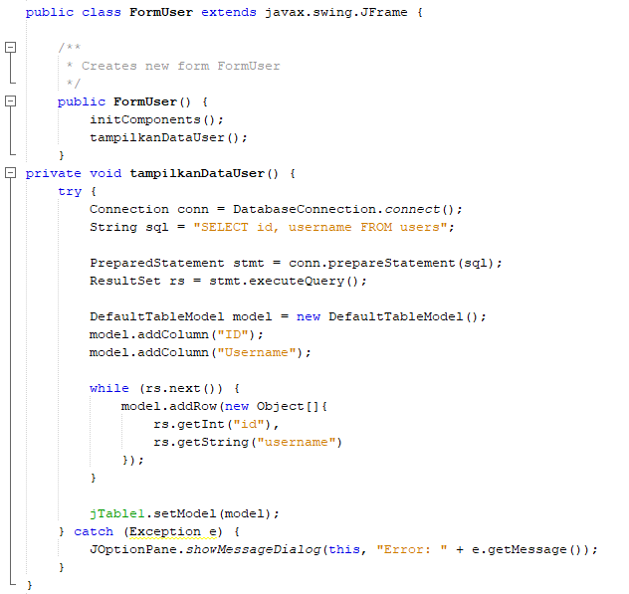
Buatlah method dan konstruktor tampilkandatauser, pada Jframe FormUser

Slide 5
Masukkan perintah pada button TambahData, sebagai berikut :
String username = jTextField1.getText().trim();
//String password = new String(jPasswordField1.getPassword()).trim();
String rawPassword = new String(jPasswordField1.getPassword()).trim();
String password = HashUtil.hashPassword(rawPassword);
if (username.isEmpty() || password.isEmpty()) {
JOptionPane.showMessageDialog(this, "Username dan Password tidak boleh kosong.");
return;
}
try {
Connection conn = DatabaseConnection.connect();
String cekQuery = "SELECT COUNT(*) FROM users WHERE username = ?";
PreparedStatement cekStmt = conn.prepareStatement(cekQuery);
cekStmt.setString(1, username);
ResultSet rs = cekStmt.executeQuery();
rs.next();
if (rs.getInt(1) > 0) {
JOptionPane.showMessageDialog(this, "Username sudah digunakan!");
return;
}

Slide 6
Lanjutan
String insertQuery = "INSERT INTO users (username, password) VALUES (?, ?)";
PreparedStatement stmt = conn.prepareStatement(insertQuery);
stmt.setString(1, username);
stmt.setString(2, password);
stmt.executeUpdate();
JOptionPane.showMessageDialog(this, "Data berhasil disimpan.");
jTextField1.setText("");
jPasswordField1.setText("");
} catch (Exception e) {
JOptionPane.showMessageDialog(this, "Gagal menyimpan: " + e.getMessage());
}

Slide 7
Masukkan perintah pada button LihatData, sebagai berikut :
try {
Connection conn = DatabaseConnection.connect();
String sql = "SELECT id, username FROM users"; // Jangan tampilkan password
PreparedStatement stmt = conn.prepareStatement(sql);
ResultSet rs = stmt.executeQuery();
DefaultTableModel model = new DefaultTableModel();
model.addColumn("ID");
model.addColumn("Username");
while (rs.next()) {
model.addRow(new Object[]{
rs.getInt("id"),
rs.getString("username")
});
}
jTable1.setModel(model);
} catch (Exception e) {
JOptionPane.showMessageDialog(this, "Error: " + e.getMessage());
}

Slide 8
Buatlah new Class, dengan nama “DatabaseConnection”, masukkan source dibawah:
public class DatabaseConnection {
public static Connection connect() {
Connection conn = null;
try {
Class.forName("com.mysql.cj.jdbc.Driver");
conn = DriverManager.getConnection(
"jdbc:mysql://localhost:3306/db_user", "root", ""); // Ubah sesuai
System.out.println("Koneksi berhasil");
} catch (Exception e) {
System.out.println("Koneksi gagal: " + e.getMessage());
}
return conn;
}
}

Slide 9
Buatlah new class dengan nama “HashUtil”
public static String hashPassword(String password) {
try {
MessageDigest md = MessageDigest.getInstance("SHA-256");
byte[] hash = md.digest(password.getBytes("UTF-8"));
// Ubah byte array ke hex string
StringBuilder hexString = new StringBuilder();
for (byte b : hash) {
hexString.append(String.format("%02x", b));
}
return hexString.toString();
} catch (Exception e) {
throw new RuntimeException(e);
}
}

Slide 10
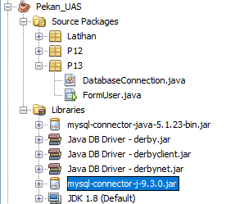
Masukkan library connection

Slide 11
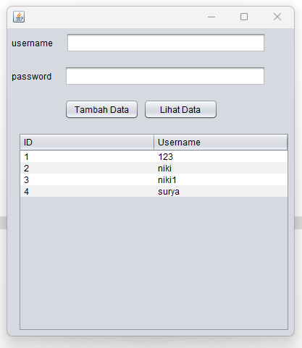
Test Run

Slide 12
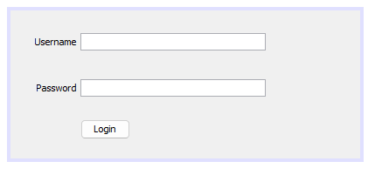
Buatlah Jframe “LoginForm”
Desain sebagai berikut :

Slide 13
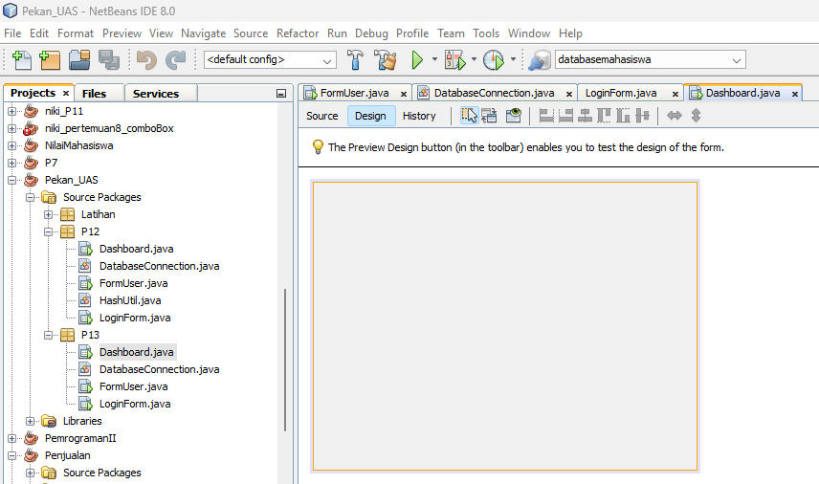
Buatlah jFrame Dashboard tanpa desain :

Slide 14
Perintah Login pada button Login di LoginForm
String username = jTextField1.getText().trim();
String inputPassword = new String(jPasswordField1.getPassword()).trim();
if (username.isEmpty() || inputPassword.isEmpty()) {
JOptionPane.showMessageDialog(this, "Username dan Password harus diisi.");
return;
}
try {
Connection conn = DatabaseConnection.connect();
String sql = "SELECT password FROM users WHERE username = ?";
PreparedStatement stmt = conn.prepareStatement(sql);
stmt.setString(1, username);
ResultSet rs = stmt.executeQuery();

Slide 15
Lanjutan
if (rs.next()) {
String dbHashedPassword = rs.getString("password");
String inputHashed = HashUtil.hashPassword(inputPassword); // Pastikan hash sama dengan penyimpanan
if (dbHashedPassword.equals(inputHashed)) {
JOptionPane.showMessageDialog(this, "Login berhasil!");
new Dashboard().setVisible(true);
this.dispose(); // Tutup form login
} else {
JOptionPane.showMessageDialog(this, "Password salah!");
}
} else {
JOptionPane.showMessageDialog(this, "Username tidak ditemukan!");
}
} catch (Exception e) {
JOptionPane.showMessageDialog(this, "Error: " + e.getMessage());
}

